Slide 1
Starcraft 2 in C#/ADO/MVC
A first attempt by Jason Slemons

Slide 2

Introduction
Life according to Jason
C#, ADO, ASP & MVC (Use all 3 and make it fun)

Slide 3
Outline
What is SC2
How to play
Basic strategy assumptions
The Question
The Solution(high level design)
Examples/How it works
Notes:
‘Fast banshee build order’, rax at 120, factory at 208, starport at 256, add ons at 332, pop at 430.

Slide 4
What is SC2
Real time strategy game.
Resource management(minerals/gas)
Human vs Human
National sport in S. Korea

Slide 5
How do you play?
Start with base and harvesters
Gather minerals/gas and spend
units, buildings, upgrades
Destroy opponents units/buildings
Loose buildings; loose game.
Examples of things to spend on:
Notes:
For adolescent boys; not complicated. Spend on buildings, units, upgrades.

Slide 6
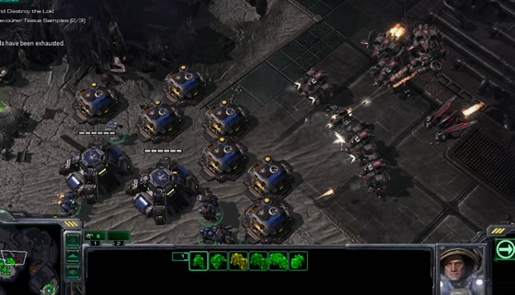
examples
Notes:
Bunker, supply depot, harvester, marine, planes,

Slide 7
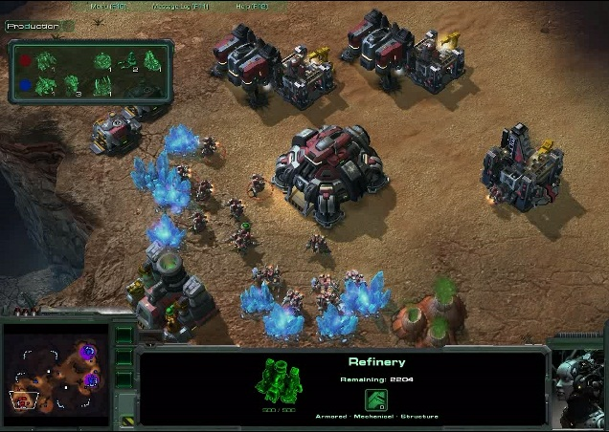
Notes:
Refinery, base, harvesters, barracks, minerals, gas.

Slide 8
Basic opening strategies?

Slide 9
Basic opening strategies?
Rush(“6 rax”, “proxy”)
Greedy(“rax expand”)
Safe(“3 rax”, “one one one”)
Notes:
Knowing when your opponent is weak informs when you should be strong(are they weak in beginning? Then Rush).

Slide 10
Example of a rush
http://www.youtube.com/watch?v=nS13Ci33GoM
Barracks at 120
Factory at 207
Starports at 252
Tech labs at 330
Pop at 430

Slide 11
Know when to stop producing harvesters/buildings and only produce attacking units/upgrades

Slide 12
The Question
Most games are one battle long
Attack as soon as your army is at its strongest
This is called ‘a timing attack’
At what time can you have a certain size army?
Notes:
Timing on the clock; doesn’t have to do with your opponent. Finish an upgrade, or a certain strong unit.

Slide 13
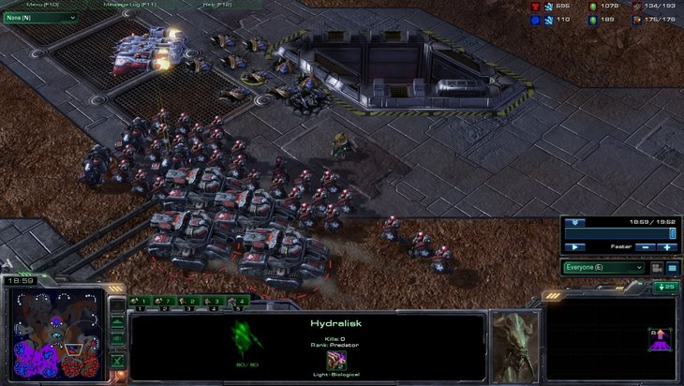
Timing push at 19

Slide 14
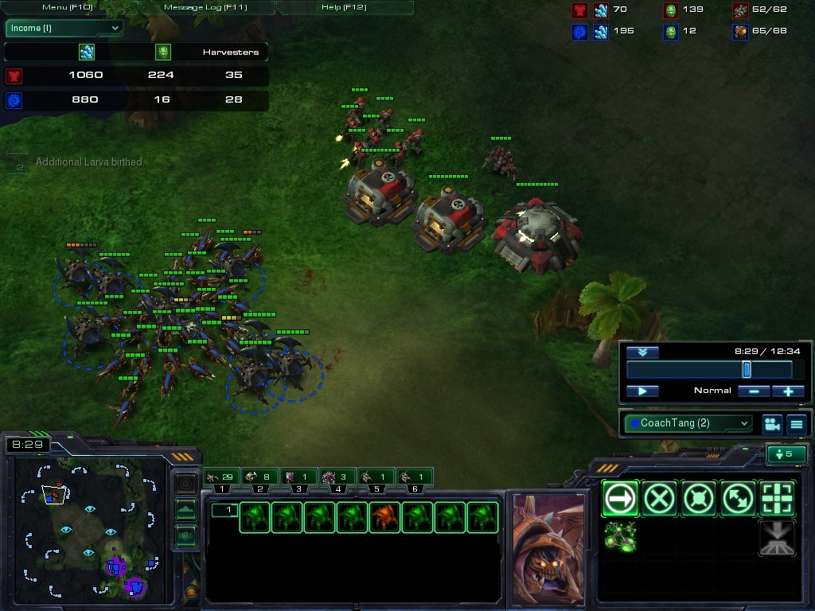
Zerg timing at 8:29

Slide 15
My Solution
Have a searchable database of army sizes(units, upgrades, etc.) and how long they each take to build.
Each entry is a game
You could search when strong armies are possible.
Create a ‘timing’

Slide 16
My Solution
Write C# program that makes legal moves at (almost) random
Keep track of all the resources, units, building, upgrades.
Save games to DB
Allow replays from DB games that are ‘good’ to get closer to optimal timing
Automatic Player and (manual) Player modes
Notes:
15 min? always building policy

Slide 17
Class Diagram
Abstract Classes: Unit, Upgrade, Structure
Interface: IBuildable, IAddon
Struct: Move
Notes:
snd\slemons_cp can use notes if needed

Slide 18
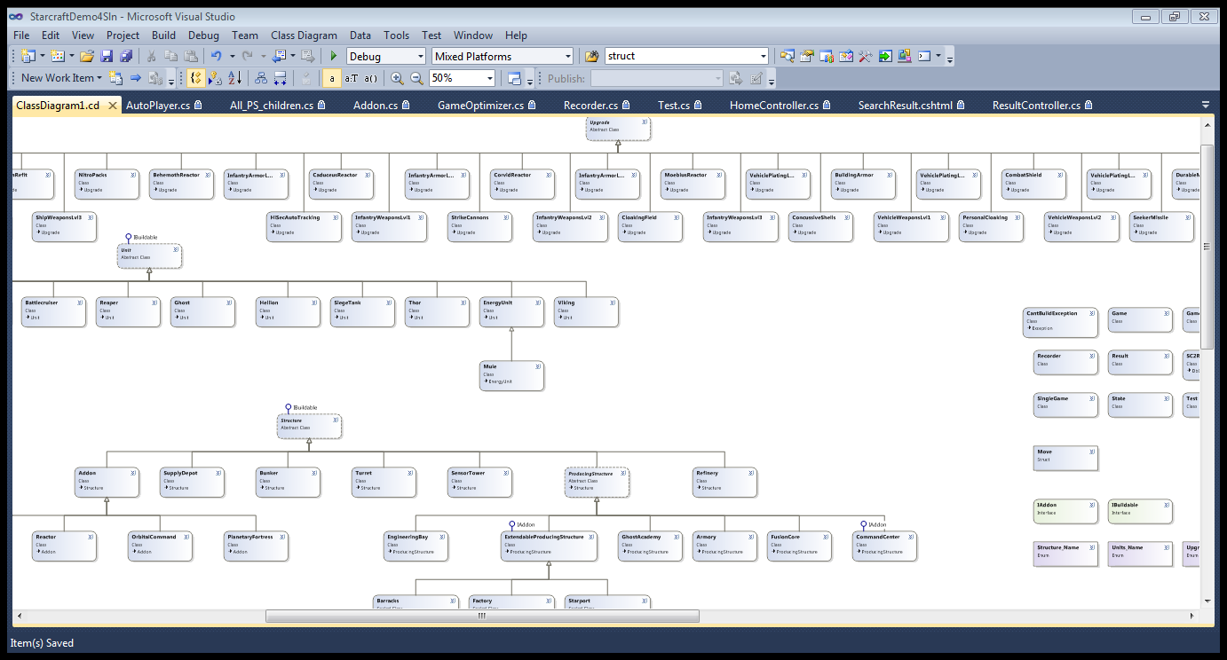

Slide 19
Run the code
Player, AutoPlayer
State
SingleGame
GameOptimizer
PlayBaseGames

